Slide 1
GLOBAL ISSUES

Slide 2
WHAT IS GLOBALISATION?

Slide 3
WHAT IS GLOBALISATION?
‘The simple definition of globalisation is the interweaving of markets, technology, information systems and telecommunications systems in a way that is shrinking the world from a size medium to a size small, and enabling each of us to reach around the world farther, faster, deeper, and cheaper than ever before, and enabling the world to reach into each of us farther, faster, deeper, cheaper than ever before. That's what globalisation is.’ (Thomas Friedman)

Slide 4
GENERAL PROBLEMS

Slide 5
GENERAL PROBLEMS
• Racism
• Poverty
• Discrimination
• Homelessness
• Media literacy
• Human rights
• Peace and conflict
• Consumer education
• Sustainability of natural resources

Slide 6
IN DETAIL

Slide 7
IN DETAIL
• discrimination
• equal opportunities
• racism
• human rights in general
• globalisation and the world economy
• health
• the impact of the media
• consumer education
• environmental concerns
• conflict and peace
• poverty
• use/misuse of natural resources
• peoples of the world
• earth care
• fair trade
• indigenous knowledge
• the arms trade
• genetically-modified organisms (GMOs)
• homelessness
• disappearing languages
• social in/justice
• perceptions and stereotypes
• sustainability
• living in a world at war
• refugees

Slide 8
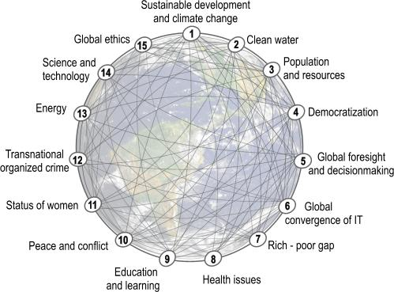
IN DETAIL
http://www.millennium-project.org/millennium/challenges.html

Slide 9
GLOBAL ECONOMY

Slide 10
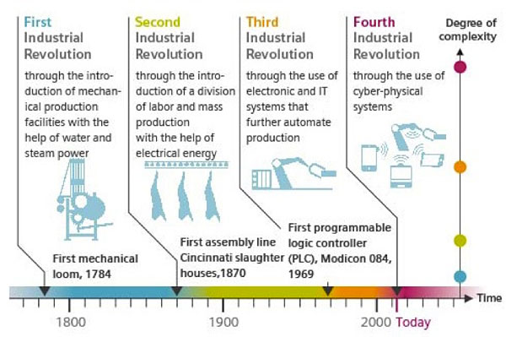
GLOBAL ECONOMY

Slide 11
POSTCOLONIALISM THE OTHER

Slide 12
GLOBAL ECONOMY
Otherness
• The Empire is dead. So is the ‘English’ literature of the Empire
• Several waves of migration have created large communities of non-British citizens in the country, who are the others next door, people who keep their own traditions and have to cope with the British cultural habits
• They represent a different voice in the debate on contemporary issues, like race, class and gender, typical of the post-colonial period
• They are not the only alternative voices: many other writers all over the world previously controlled by Britain are now expressing a decentred point of view on human condition in their countries. They are the people out there, still writing in English to make
their voices heard everywhere

Slide 13
GLOBAL ECONOMY
The Others Next Door
Post-colonial issues are the subject matter of the works of these writers and may be summed up as follows:
• Identity: it is no longer a word with a single meaning but highlights the plurality of the identities of people belonging to two contrasting worlds
• Culture and tradition: post-colonial writers try to recuperate their identity through memory and the folk heritage of their native country
• Belief and religion: they underline their native heritage: Animism coexists with monotheism, superstitions and tribal beliefs
• Language: the confrontation between standard English and the writers’ native languages (creoles) is a way to show their race pride. Reshaping the English language is a need and each poet contributes to the creation of ‘New Englishes’. There is a close link between language and music in this research
• Location or sense of displacement: many of these artists have Commonwealth origins and feel apart from British society and landscape, thus creating alternative backgrounds in their works

Slide 14
WOLE SOYINKA
Telephone Conversation
(1963)

Slide 15
TELEPHONE CONVERSATION

Slide 16
TELEPHONE CONVERSATION
• It is a biting satire against the racist attitudes of whites in the 20th century. • It ridicules the social evil and human weakness of racial prejudice.
Characters
• A black, educated man
• A white landlady
Topic
• Renting a flat to a black man
Theme
• Racism
u Lyric Poem – Recounting a personal event, in the present tense,
in the form of a dialogue
u Free Verse – The lack of structure represents the spontaneity and realism of the conversation, as well as the lack of rhyme
u Caesura – Abrupt stops representing the disgust of the speaker, drawing attention to how horrible the woman’s racism is, building tension
u Irony

Slide 17
HANIF KUREISHI
My Son the Fanatic
(1994, The New Yorker, then published in Love in a Blue Time, 1997)

Slide 18
HANIF KUREISHI − ISSUES
Kureishi explores what is to be a ‘half-caste’ in Britain and focuses on the issues such as:
• home
• homelands
• belonging
• inbetweenness
• alienation
• identity
• hybridity
• nationalism
• racism
• sexuality
• fundamentalism
• migration
• ethnicity
• historical and cultural conflict between East and West

Slide 19
HANIF KUREISHI
My Son the Fanatic
Themes of
• fundamentalism
• influence of Islam in a multicultural community
The conflict between European and Muslim values results in intolerance and violence, and a family whose roots are in
two distinct cultures is torn apart.

Slide 20
HANIF KUREISHI
My Son the Fanatic
PLOT
Parvez, a Muslim taxi driver in a big city, is puzzled by a change in his son’s behaviour and starts looking for explanations, inspecting the boy’s room.
The old Ali
The new Ali
• English girlfriend
• messy
• plays guitar
• did sports
• went out a lot
• room is well structured
• sells his things
• donates his things
Parvez seeks help and asks the other taxi drivers and a prostitute called Bettina. After observing his son, he finds out he has become a strict Muslim. When he asks Ali about his return to religion, Ali becomes mad and attacks Parvez’s sinful Western lifestyle and also insults Bettina.
Parvez gets furious and, once home, gets drunk and strikes his son Ali.
‘So who’s the fanatic now?’

Slide 21
HANIF KUREISHI
My Son the Fanatic
The structure of the story
Parvez beats Ali (p. 200; I. 4ff)
CLIMAX
EXPOSITION
RISING ACTION
CONFLICT ISN’T SOLVED
Ali’s change
first real conflict
‘So who’s the fanatic now?’
(p. 200; I. 9)

Slide 22
HANIF KUREISHI
My Son The Fanatic
MESSAGE
• divergence in the ideologies creates a ground for conflict and
disharmony
• Ali feels like an outcast, marginalised and stereotyped in the West, tries to impose his identity with more assertion to counter the Western culture
Thanks to his hybrid identity, Kureishi gives an impartial view of both the cultures.

